Slide 1




Slide 2

TEST TIME ON PRESENTATION SKILLS 1.6(DEALING WITH QUESTIONS)
URL: https://forms.gle/tb3omtF1Lb9Mjmvf8
QR CODE:

Slide 3

MENSURATION

Slide 4
INTRODUCTION
Mensuration is a topic in Geometry which is a branch of mathematics. deals with length, area and volume of different kinds of shape- both 2D and 3D.
A 2D shapes have no depth or height; they have two dimensions- length and breadth. For 2D shapes, we measure area (A) and perimeter (P).
A 3D shape have three dimensions- length, breadth and height/depth.
For 3D shapes we measure Volume (V), Curved Surface Area (CSA), Lateral Surface Area (LSA) and Total Surface Area (TSA).

Slide 5
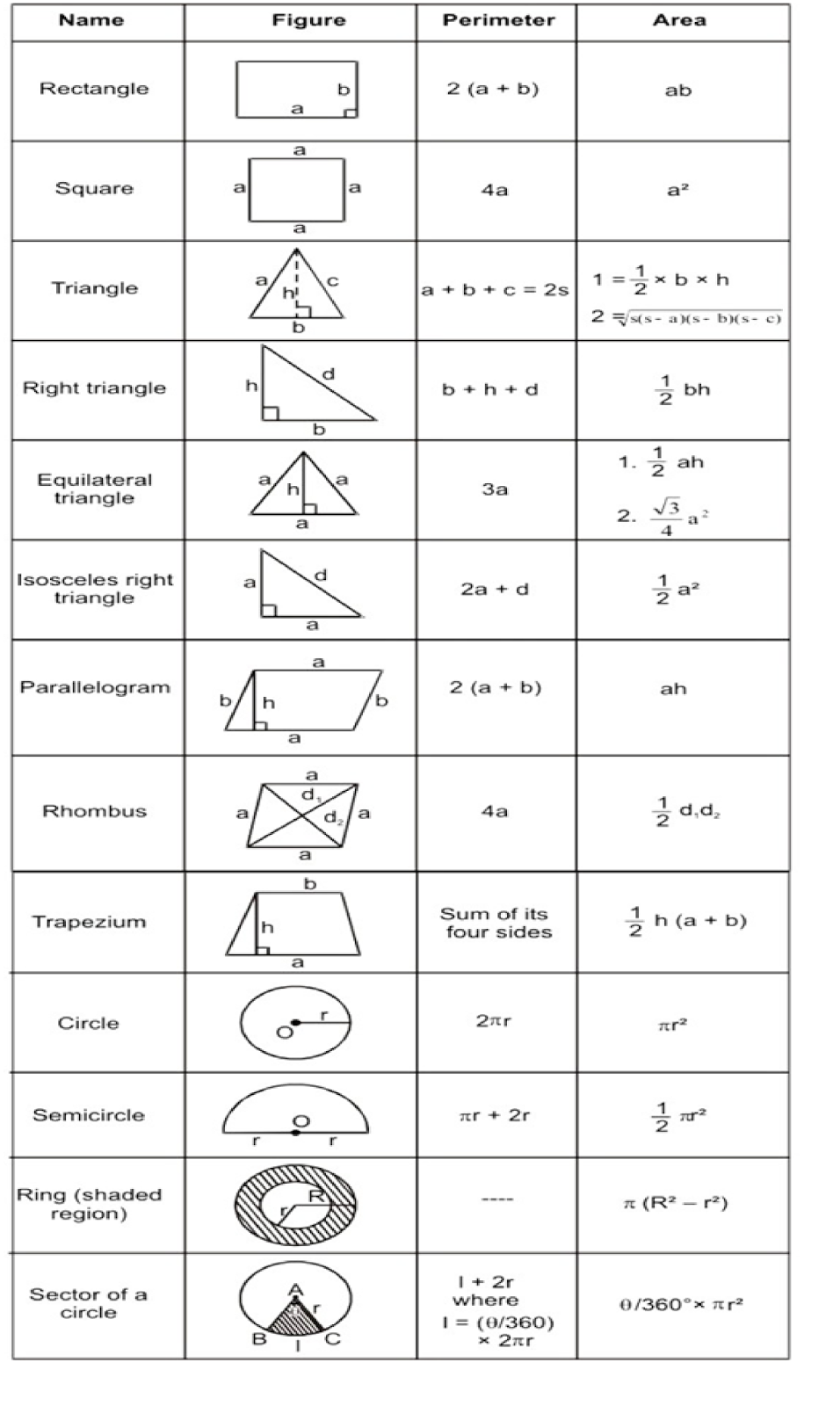
FORMULAE

Slide 6
FORMULAE

Slide 7
FORMULAE

Slide 8
FORMULAE

Slide 9
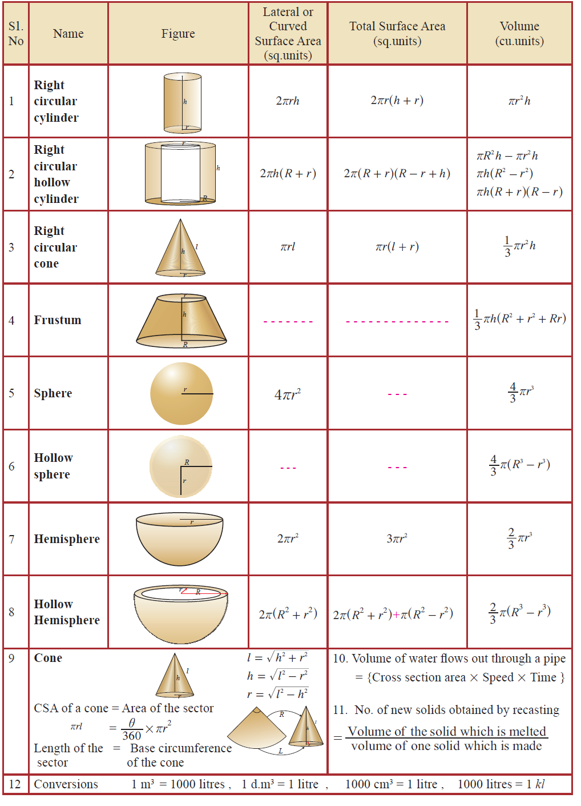
FORMULAE

Slide 10
FORMULAE

Slide 11
FORMULAE

Slide 12
Question: 01
Find the area of trapezium whose parallel sides are 20 cm and 18 cm long, and the distance between them is 15 cm.
A. 225 cm²
B. 275 cm²
C. 285 cm²
D. 315 cm²
E. None of these
Answer : C

Slide 13
Explanation: 01
Area of a trapezium = 1/2 (sum of parallel sides) * (perpendicular distance between them)
= 1/2 (20 + 18) * (15)
= 285 cm²

Slide 14
Question: 02
Find the area of a parallelogram with base 24 cm and height 16 cm.
A. 262 cm²
B. 384 cm²
C. 192 cm²
D. 131 cm²
E. None of these
Answer : B

Slide 15
Explanation: 02
Area of a parallelogram=bh
= 24*16
=384 cm²

Slide 16
Question: 03
A horse is tethered by a rope 10 m long at a point. Find the area of the region where it can graze (π = 3.14 )
A. 314 cm²
B. 31.4 cm²
C. 314 m²
D. 31.4 m²
Answer : A

Slide 17
Explanation: 03
The area of the region the horse can graze is circular with a radius equal to the length of the rope.
Area of the circle is πr² = 3.14 × 10² = 3.14 × 100 =314 Hence the area of the region the horse can graze is 314cm²

Slide 18
Question: 04
The length of a room exceeds the breadth by 2 metres. If both the length and the breadth are increased by 1 meter, then the area of the room is increased by 11 sq. m. Find the length and the breadth of the room.
A. 3m and 2 m
B. 2m and 7m
C. 7m and 9m
D. 6m and 4m
Answer : D

Slide 19
Explanation: 04
Solution: D. Let the breadth of the room is x meter. Then,
length of room = x+ 2 (given) and area of room = (x+2) x sq meter
If length and breadth increased 1 meter, length = (x+2) + 1 = x + 3 meter and breadth = x + 1 meter Then area of new room = ( x + 3) (x + 1) sq m
As per given in question
( x + 3) (x + 1) – (x+2)x = 11
= x² + 4x + 3 – x² -2x = 11
= 2x = 8
x = 4
So breadth of room = 4
And length of room = 4 + 2 = 6

Slide 20
Question: 05
The length of a rectangular plot is thrice its breadth. If the area of the rectangular plot is 867 sq m, then what is the breadth of the rectangular plot?
A. 8.5 m
B. 17 m
C. 34 m
D. 51 m
E. None of these
Answer : B

Slide 21
Explanation: 05
Let the breadth of the plot be b m.
Length of the plot = 3 b m
(3b)(b) = 867
3b² = 867
b² = 289 = 17² (b > 0)
b = 17 m.

Slide 22
Question: 06
The area of a square is equal to five times the area of a rectangle of dimensions 125 cm * 64 cm. What is the perimeter of the square?
A. 600 m
B. 800 m
C. 400 m
D. 1000 m
Answer : B

Slide 23
Explanation: 06
Area of the square = s * s = 5(125 * 64)
=> s = 25 * 8 = 200 cm
Perimeter of the square = 4 * 200 = 800 cm.

Slide 24
Question: 07
A wire in the form of a circle of radius 3.5 m is bent in the form of a rectangule, whose length and breadth are in the ratio of 6 : 5. What is the area of the rectangle?
A. 60 cm²
B. 40 cm²
C. 30 cm²
D. 15 cm²
Answer : C

Slide 25
Explanation: 07
The circumference of the circle is equal to the permeter of the rectangle.
Let l = 6x and b = 5x 2(6x + 5x) = 2 * 22/7 * 3.5
=> x = 1
Therefore l = 6 cm and b = 5 cm Area of the rectangle = 6 * 5 = 30 cm²

Slide 26
Question: 08
The area of a square is 4096 sq cm. Find the ratio of the breadth and the length of a rectangle whose length is twice the side of the square and breadth is 24 cm less than the side of the square.
A. 18 : 5
B. 7 : 16
C. 5 : 14
D. 5 : 16
Answer : D

Slide 27
Explanation: 08
Let the length and the breadth of the rectangle be l cm and b cm respectively. Let the side of the square be a cm.
a2 = 4096 = 2¹²
a = (2¹²)^{1/2} = 2⁶ = 64
L = 2a and b = a - 24
b : l = a - 24 : 2a = 40 : 128 = 5 : 16

Slide 28
Question: 09
The parameter of a square is double the perimeter of a rectangle. The area of the rectangle is 480 sq cm. Find the area of the square.
A. 200 sq cm
B. 72 sq cm
C. 162 sq cm
D. Cannot be determined
Answer : D

Slide 29
Explanation: 09
Let the side of the square be a cm. Let the length and the breadth of the rectangle be l cm and b cm respectively.
4a = 2(l + b)
2a = l + b
l . b = 480
We cannot find ( l + b) only with the help of l . b. Therefore a cannot be found .
Area of the square cannot be found.

Slide 30
Question: 10
The dimensions of a room are 25 feet * 15 feet * 12 feet. What is the cost of white washing the four walls of the room at Rs. 5 per square feet if there is one door of dimensions 6 feet * 3 feet and three windows of dimensions 4 feet * 3 feet each ?
A. Rs. 4800
B. Rs. 3600
C. Rs. 4530
D. Rs. 3560
Answer : C

Slide 31
Explanation: 10
Area of the four walls = 2h(l + b)
Since there are doors and windows, area of the walls = 2 * 12 (15 + 25) - (6 * 3) - 3(4 * 3) = 906 sq.ft.
Total cost = 906 * 5 = Rs. 4530

Slide 32
Question: 11
Find the total surface area of a container in cylindrical shape whose diameter is 28cm and height is 15cm.
A. 2552
B. 3644
C. 4536
D. 3562
Answer : A

Slide 33
Explanation: 11
solution, Given, diameter = 28cm, so radius = 28/2 = 14cm
and height = 15cm
By the formula of total surface are, we know;
TSA = 2πr (h + r) = 2x 22/7 x 14 x (15 + 14)
TSA = 2 x 22 x 2 x 29
TSA = 2552 sq.cm
Hence, the total surface area of container is 2552 sq.cm.

Slide 34
Question: 12
Calculate the cost required to paint a container which is in shape of a right circular cylinder having a base radius of 7 m and height 13 m. If the painting cost of the container is INR 2.5/m². (Take π = 22/7)
A. Rs. 4800
B. Rs. 2200
C. Rs. 2530
D. Rs. 3560
Answer : B

Slide 35
Explanation: 12
Total surface area of aquarium = 2πr (h + r)= 2 x 22/7 x 7 x 20 = 880 m²
Total cost of painting the container = 2.5 × 880 = Rs. 2200

Slide 36
Question: 13
The radius of hemispherical balloon increase from 7 cm to 14 cm as air is being pumped into it. Find the ratios of the surface areas of the balloon in two cases.
A. 1:5
B. 1:6
C. 1:4
D. 1:3
Answer : C

Slide 37
Explanation: 13
For 1st hemisphere, r = 7 cm TSA -1 = 3 π r ² ⇒ = 3 x π x 7 ² TSA-1 3 π x 7² 1 -------- = --------- = ---- TSA -2 3π x 14² 4⇒ S ₁ : S ₂ = 1 : 4

Slide 38
Question: 14
A toy is in the shape of a cylinder surmounted by a hemisphere. The height of the toy is 25 cm. Find the total surface area of the toy if its common diameter is 12 cm.
A. 1800
B. 1056
C. 1230
D. 1560
Answer : B

Slide 39
Explanation: 14
Let r and h be the radius and height of the cylinder respectively.
Given that, diameter d = 12 cm, radius r = 6 cm
Total height of the toy is 25 cm
Therefore, height of the cylindrical portion = 25 − 6 = 19 cm
T.S.A. of the toy = C.S.A. of the cylinder + C.S.A. of the hemisphere +Base Area of the cylinder
= 2πrh + 2πr ² + πr ²
= πr (2h + 3r) sq. units
= (22/7) × 6 × (38 + 18)
= (22/7) × 6 ×56 = 1056
Therefore, T.S.A. of the toy is 1056 cm²

Slide 40
Question: 15
A funnel consists of a frustum of a cone attached to a cylindrical portion 12 cm long attached at the bottom. If the total height be 20 cm, diameter of the cylindrical portion be 12 cm and the diameter of the top of the funnel be 24 cm. Find the outer surface area of the funnel.
A. Rs. 4800
B. Rs. 3600
C. Rs. 4530
D. Rs. 4500
Answer : C

Slide 41
Explanation: 15
Area of the four walls = 2h(l + b)
Since there are doors and windows, area of the walls = 2 * 12 (15 + 25) - (6 * 3) - 3(4 * 3) = 906 sq.ft.
Total cost = 906 * 5 = Rs. 4530

Slide 42




THANK YOU
+91 78150 95095
codemithra@ethnus.com
www.codemithra.com

